Slide 1
Insurance Contributory
Trends and Benchmarking

Slide 2
Project Requirements
Purpose is to benchmark the insurance market
LN CLUE. Includes Clue commercial, CLUE, and Claims Discovery
We are looking to measure severity, frequency, and average cost of accuracy
For closed claims we will need counts, amounts, lag time, days to pay.
These alerts will be at the carrier / state / coverage level and monthly
Be careful with data because of COVID

Slide 3
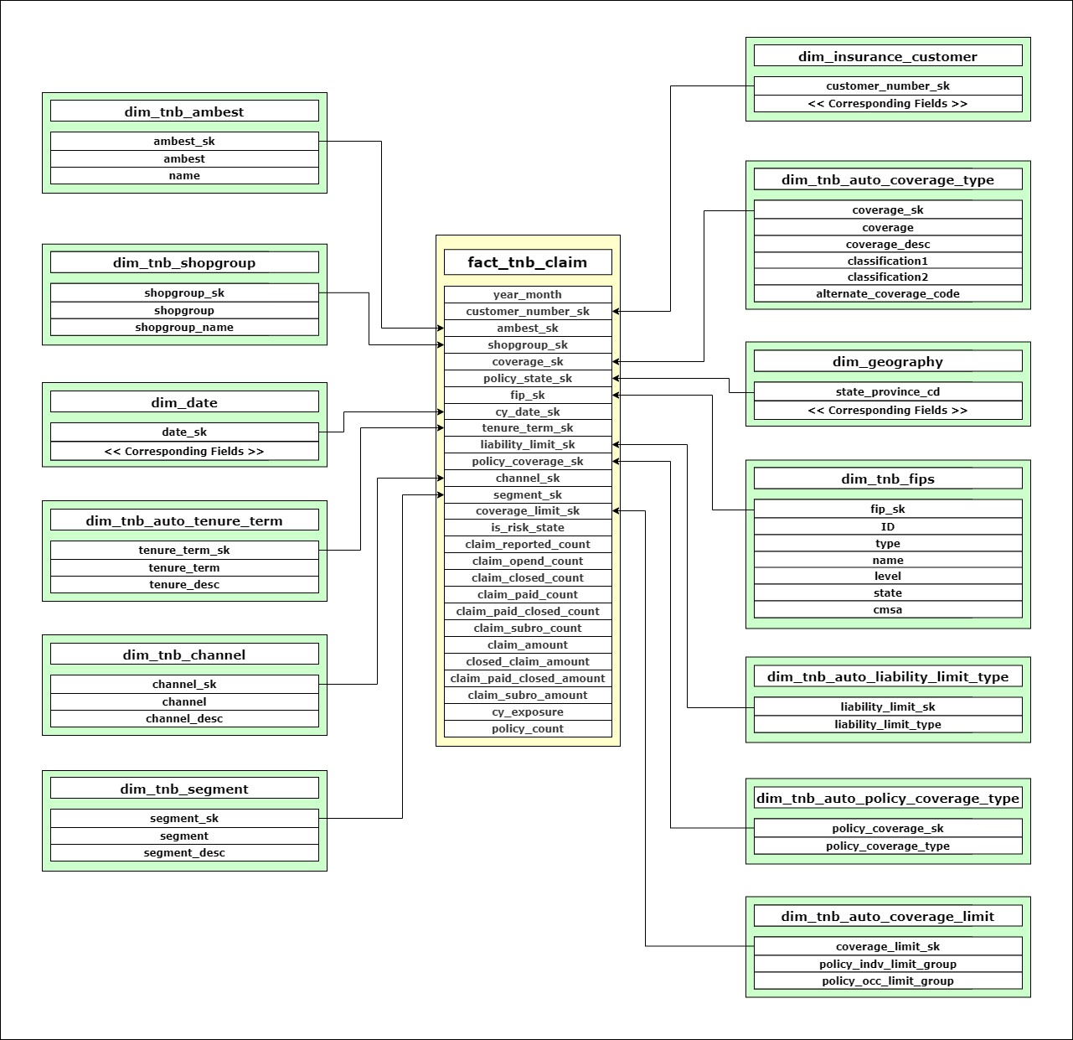
fact_tnb_claim

Slide 4
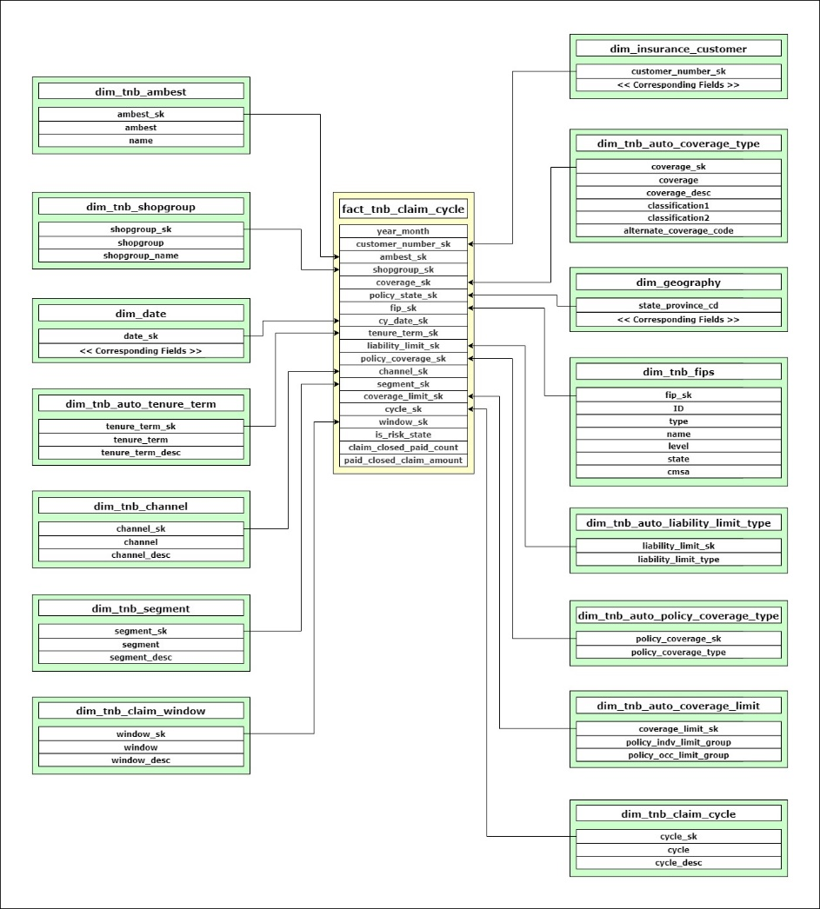
fact_tnb_claim_cycle

Slide 5
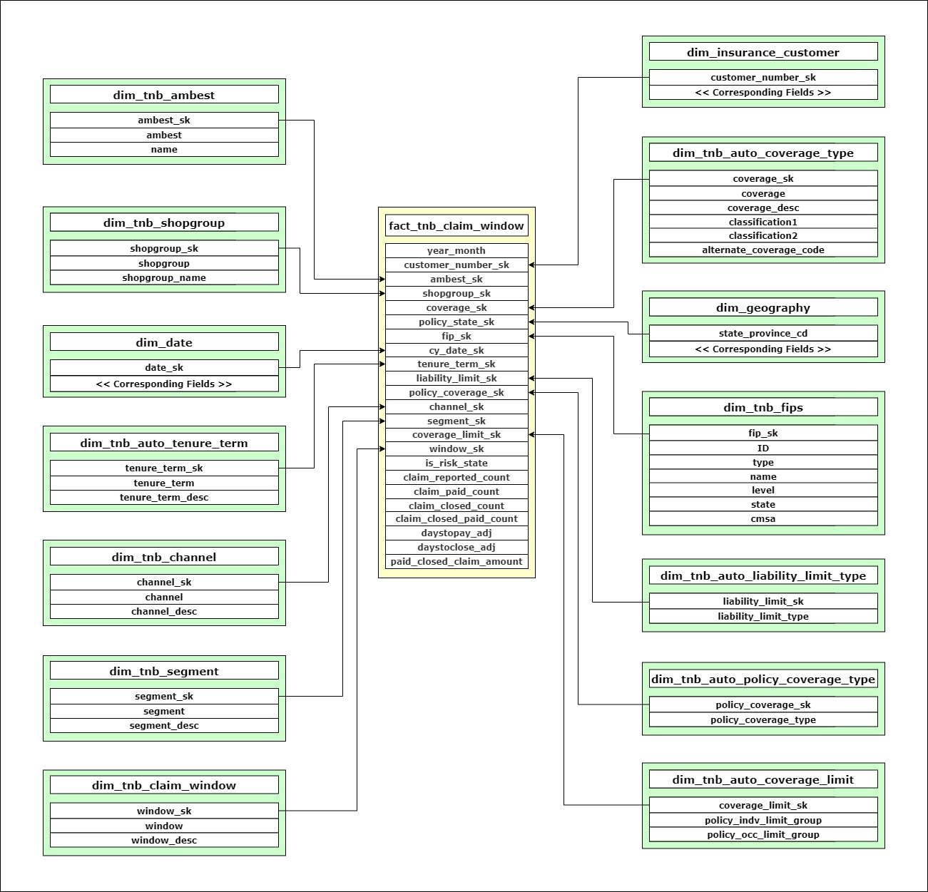
fact_tnb_claim_window

Slide 6
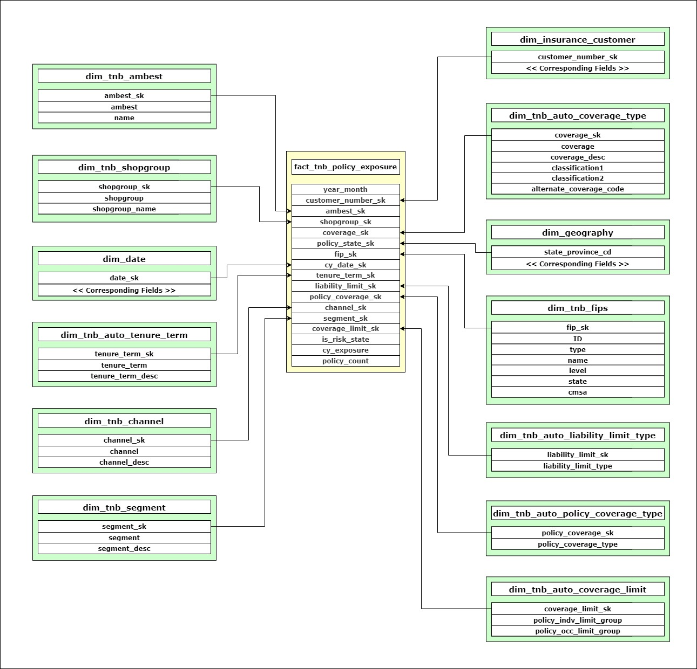
fact_tnb_policy_exposure

